Slide 1
Session 5
Writing non-empirical Papers: Developing arguments
MCCP7020
Language Centre
Hong Kong Baptist University

Slide 2
Research paper on creative works:
In communication, according to my observation, research is often done on the analysis of a limited number of creative works (e.g. 2-3 products/films)
This type of research is more of qualitative nature, NOT involving much data collection. However, such research emphasizes on the development of arguments, conceptualization of certain observations, formation of even theories.
The communication papers are, therefore, not organised following the typical structure of empirical RAs, i.e., the IMRaD structure. Rather, they are often organised according to the themes of the analysis.
In the next few slides, you will see observations of the development of literary critical papers, which I think bear much similarity to writing in communication.

Slide 3
1. Moves (Propositions)
Shaw (1998) and MacMonald (1994) found that critique type of writing in humanities often has more phenomenally-oriented introductions which launch directly into discussion of the topic of the article.
Shaw (1998), by examining research journal articles in this field, proposed essential moves of this type of RAs. See the next slide.

Slide 4
Move (Proposition type) | Example
Aim of the Study | I will focus on the anomalous figure of the woman political orator as she is figured in.. ...Henry James' The Bostonians
Gap Indication | ..current critical accounts of women's speech in nineteenth-century America, which consistently fail to acknowledge the political interests structuring the associations between women's speech and sexual identity
Claim | Such writers described and attempted to curb women's persistent public outspokenness by invoking as an emblem the body that they thought of as determining female language.
Data Interpretation (Background) | In title Ellin Devis similarly claimed that for women verbal forwardness leads to charges of sexual forwardness and that 'a multitude of words, is no advantage to....women'.
Data Interpretation (Interpretive recount, i.e. summary of the examined work including character, plot, and other details) | ...Though she escapes, she is 'herself no longer'. The hostile voices in the audience cause Marian to reanalyse her own and then to hear another during her ensuing illness.....
Review critics | … compelled these elite men, as Cmiel notes, to modify their rhetorical practices

Slide 5
2. Another pattern of developing arguments:
Tucker (2004) analysed the same type of writing and suggested similar patterns of developing arguments:
Preview claim –> quotation –> interpretive recount –>
claim marker –> claim

Slide 6
3. Another way of organizing conceptual/critique papers:
When Nolan & Rocco (2009) taught their Humanities students to write conceptual papers, they introduced the following structure to their students.
(a) Introduction
(background to problem, problem statement, purpose, organizing questions or objectives, and a conceptual/theoretical framework),
(b) Discussion
(organized around themes or categories or headings that guide the argument),
(c) Implications
(sometimes with tables or diagrams to illustrate the argument or discussion and specific relevance to the field) (Nolan & Rocco, 2009)

Slide 7
4. Self-manifestation in arguments
I believe this marriage symbolizes the reunion of Puritan and Catholic which was one of James I’s major policy goals.
Thus while it is reasonable to assume that the instances of ne deletion found in the children’s speech were largely developmental, it is possible that such instances could, to some extent, reflect the speech that the children were (presumably) most consistently exposed to.

Slide 8
5. Other manifestation in arguments
Keen argues that such conservative faith in the king amounts to the “greatest deception of the agrarian public” (1995 p. 23).
It was subsequently proposed that LH regions that subserve speech perception may be fundamentally specialized for the processing of rapidly changing acoustic information (Tallal, Miller, & Fitch, 1993).
Hunston (1995): “[…] the responsibility for the veracity of a statement is transferred when the statement is attributed” (1995: 134).

Slide 9
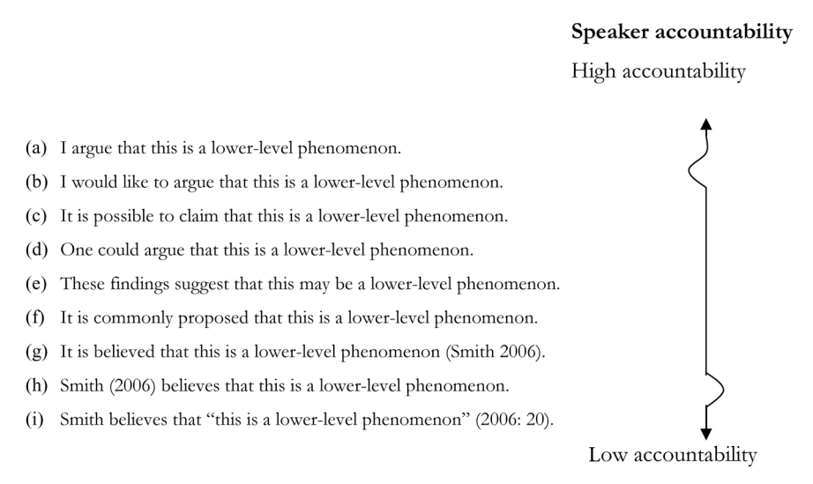

Slide 10
What you need to do:
Find one RA as an example and analyse how arguments are formed in the RA in your field.
When you analyse the moves/formation of arguments, think about the questions on the next slide.
Copy and paste one or two sections to the shared Google Doc (Note that your worksheets are No. 19, 20, 21 respectively) and complete the analysis of argument development in the article.

Slide 11
Questions to think:
By looking at the headings of the paper, can you easily see the organisation logic of the themes?
Go through the article and then identify the theories or major theoretical perspectives adopted by the writer(s). How do(es) the writer cite others’ work/theories?
When analyzing the paper, do you see any moves of argument development introduced on slides 4-6 used by the writer? Can you identify the writer(s)’ patterns of developing arguments?
How is self-manifestation and/or other-manifestation is realised in the article? Which one is more prominent in the article?

